Slide 1


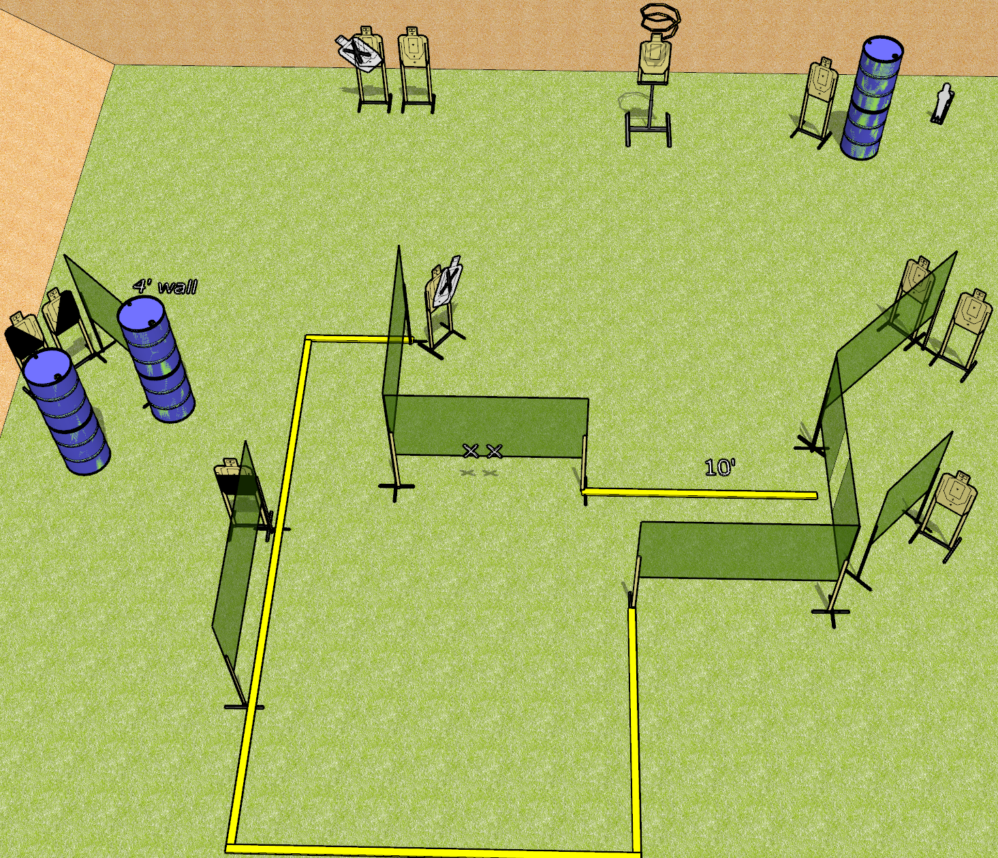
 | Dothan Gun Club – USPSA Match So Much To Do Course Designer : Drew Coleman
Round Count 23 rounds 11 USPSA targets 1 mini popper
Equipment List 14 wall feet 2 medium wall feet Drop turner + activator 1 50%, 1 left and 1 right diagonal

Slide 2
So Much To Do
Written Stage Briefing
So Much To Do is a 23 round, 115 point, Comstock course of fire. There are 11 USPSA targets and 1 mini popper. The best 2 hits on paper will score, and steel must fall to score. The start signal is audible.
The drop turner is activated by the mini popper and is visible at rest.
Handgun start position is hands touching marks. Handgun is loaded and holstered.
PCC start position is muzzle touching either mark, stock on belt. Loaded carbine is held with both hands, safety on.
On start signal, engage targets as they become available from within the shooting area.

